Slide 1
Designing the User Experience: THE FUNDAMENTALS
From Persona to Design

Slide 2
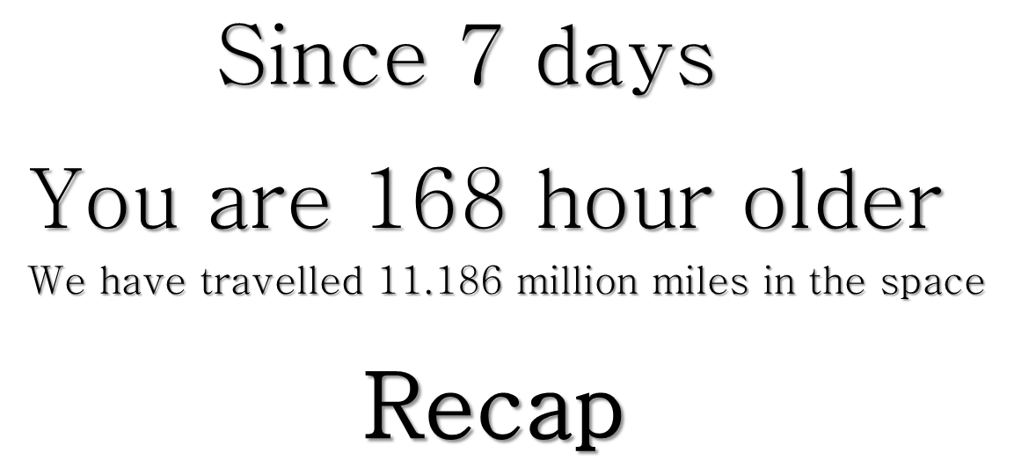

RESEARCH METHODS
Email/online Surveys
User Interviews
Card Sorting
Contextual Inquiry
Task Analysis
Diaries/Journaling
Concept Testing
Usability Testing
Eye-tracking

Slide 3
Interaction Design is the creation of a dialogue between a person and a designed artifact - a product, service, or system.

Slide 4
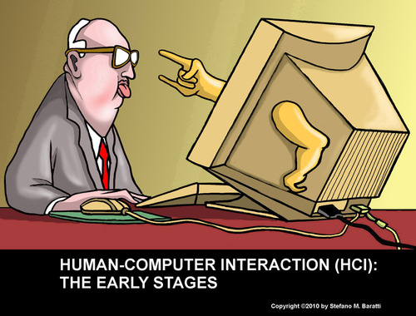
Notes:
We’re going to take that literally, here. We’re going to try out playing the computer. Using bodystorming.

Slide 5
Interaction Design the Cooper Way
Goal-directed Design
Notes:
Welcome to another session of “all the post-it notes must die!”

Slide 6
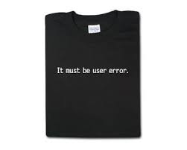
User Research
Last Week
Personas
Scenarios
Task Analysis
Use Cases
Feature Design

Slide 7
Personas & Scenarios
Advanced Barbies for Design Excellence

Slide 8

“A persona is a user
archetype you can use to help guide decisions
about product features,
navigation, interactions, and even visual design.”
- Kim Goodwin, Cooper

Slide 9

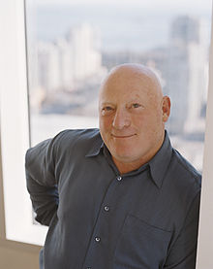
Our most effective interaction design tool is developing a precise description of our user and what he/she wishes to accomplish

Slide 10
Why do we have them?

Slide 11
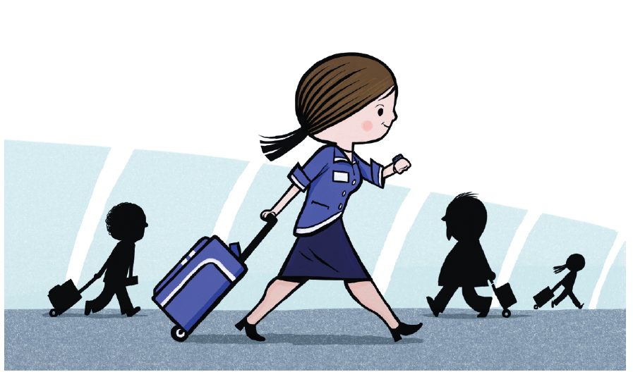
The average user doesn’t exist.
We can’t design for everyone
But maybe we can get it right for the right people
Notes:
Be a rolling suitcase (from blueprints)
In the beginning, only flight attendants had rolling suitcases. They had them because
someone who understood the flight attendant’s job designed the suitcases for a very
specific set of needs. Flight attendants needed to dash from flight to flight. They had to
stay fresh for the long flight’s exertions, so they didn’t want to get tired carrying a heavy
bag. Many flight attendants were quite petite, so carrying a big bag could be tough. And
finally were changing flights so often, they really needed to carry all their essentials on
the plane—they never knew when their job would send them to Tokyo when their bags
were already on their way to Paris.
Does this sound familiar? Ordinary people go through the same pains when they fly. We
want to carry all our valuables onto the plane with us. We need them to fi t in the overhead
compartment. We get tired of carrying bags in the long lines to the ticket counter
or while dashing from Terminal C to Terminal F. And our bags often seem to be determined
to head for Paris when we are en route to Tokyo.
A travel-savvy designer met a very specific need for a particular group extremely well,
and ultimately he met the needs of flyers everywhere.

Slide 12
You are not the User
But you can play one on TV

Slide 13
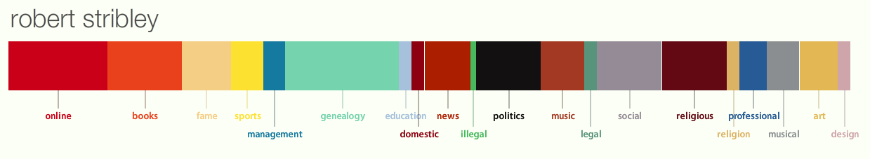
Personas
Personas is a component of the Metropath(ologies) exhibit, recently on display at the MIT Museum by the Sociable Media Group from the MIT Media Lab . It uses sophisticated natural language processing and the Internet to create a data portrait of one's aggregated online identity. In short, Personas shows you how the Internet sees you.
Created at Personas: http://personas.media.mit.edu

Slide 14
Personas
“Personas summarize user research findings and bring that research to life in such a way that everyone can make decisions based on these personas, not based on themselves.”
Steve Mulder

Slide 15

Personas
Methodology
Cluster Analysis
Goals
Create a narrative based on real data to illustrate user behavior, motivations, goals
Big Budget
Promoter
Planner
Small Budget
Notes:
Wikipedia: Cluster analysis or clustering is the assignment of a set of observations into subsets (called clusters) so that observations in the same cluster are similar in some sense

Slide 16
Personas
Characteristics of Effective Personas
Varied and distinct
Detailed
Not weighed down with minutiae
Tied into business-specific goals
Backed by data
Notes:
Goals and data from focus groups, stakeholder interviews, etc – including user behaviors and opinions

Slide 17
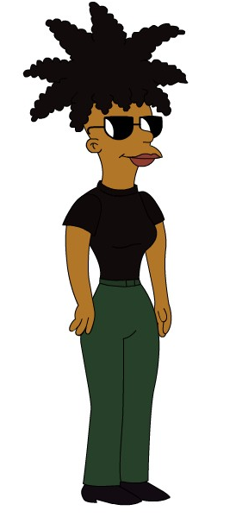
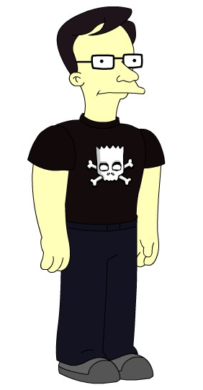
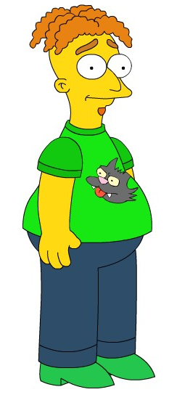
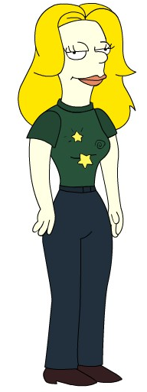
Jerry
Jenny
Donny
Sabrina

Slide 18
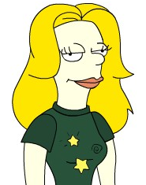
Personas
Sabrina, 27
The party planner
Location:
Gramercy Park
Attitude:
Organized, outgoing
Financial Perspective:
Generous, bit of spendthrift
Online Habits:
Avid user of social networking sites, Twitter, Facebook, etc
Events:
Wine tastings, gallery openings
Quote:
“I love getting bunches of friends together to attend all these NYC events. There’s so much great stuff to do in this city!”
Big Budget
Promoter
Planner
Small Budget

Slide 19
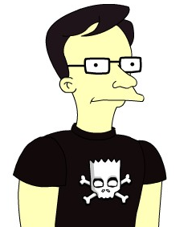
Jerry, 44
The out-of-towner
Location:
Cincinnati, OH
Attitude:
Casual, yet adventurous
Financial Perspective:
Moderate spender
Online Habits:
Utilitarian use of the Web to research trips, read about the arts and pay bills
Events:
Museums, visiting landmarks, tours
Quote:
“I’m visiting the Big Apple with my wife and we want to check out some art-related events.”
Big Budget
Promoter
Planner
Small Budget

Slide 20

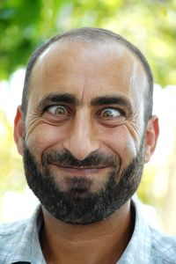
Personas
Donny, 38
The local comedian
Location:
East Village
Attitude:
Laidback, loosely organized
Financial Perspective:
Frugal, paycheck to paycheck
Online Habits:
Spends time networking, promoting his act online, haunts comedy sites
Events:
Comedy slams, variety shows
Quote:
“I land a few comedy gigs around the city and I want to promote them better.”
Big Budget
Promoter
Planned
Small Budget

Slide 21
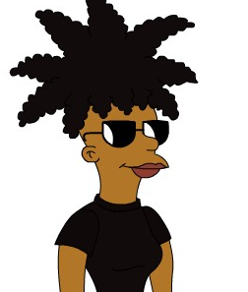
Personas
Jenny, 33
The professional promoter
Location:
Williamsburg
Attitude:
Busy, disciplined, professional
Financial Perspective:
Healthy budget for promotions and
advertising
Online Habits:
Heavy use of social networking sites both professionally and personally, shops online
Events:
Small gigs, big concerts, DJ sets
Quote:
“I manage a few bands and DJs and I have to ensure they’re listed in the right, targeted places.”
Big Budget
Promoter
Planned
Small Budget

Slide 22
Class Exercise: Personas
Jerry
Jenny
Donny
Sabrina
What tasks might each persona attempt to complete on Events.com?
What features can you imagine each persona might like on such a site?
What obstacles or pain points might they encounter?
Self Study
”Personas and the Role of Design Documentation" by Andrew Hinton, Boxes and Arrows, 2008/02/27

Slide 23
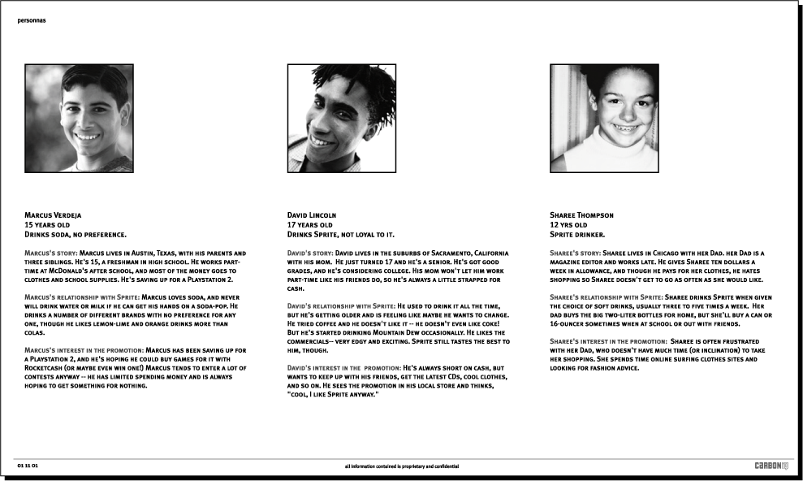
Empathy & Insight
From CarbonIQ , circa 2000
Notes:
Story about autointiated audio

Slide 24
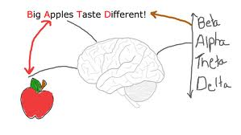
mnemonic
To remember all that research
mnemonic device, is any learning technique that aids information retention. Mnemonics aim to translate information into a form that the brain can retain better than its original form.

Slide 25
An example

Slide 26
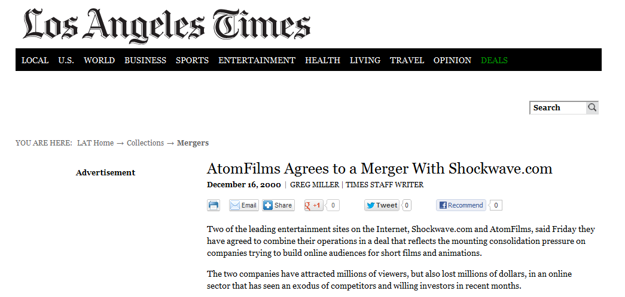
Notes:
This is a casestudy form early work I did at carbonoiq, that can be shared. But you should probably put in your own.

Slide 27
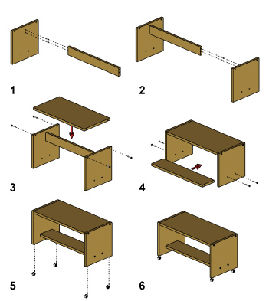
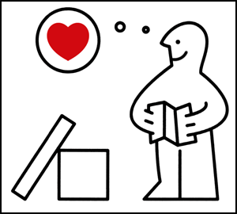
The IKEA Effect

Slide 28
PERSONA WORK SESSION
How to create:
Summarize findings, distribute to stakeholders.
Hold a work session with stakeholders & development team to brainstorm personas.
Prioritize and discard lesser personas to develop primary and supporting personas.
Notes:
1. How to: Summarize findings, distribute to stakeholders.
During discovery you gathered a ton of information. You’ve discarded the irrelevant. Now you create a report that includes relevant data on the user base. Distribute this at least 24 ours before the session.
1. How to: Hold a Work session with stakeholders & dev team to brainstorm personas.
Invite key stakeholders from each department that has contact with, connection with or investment in the end-user (yes, it could be every department in the company.) Also invite key members of the development team, or all if possible. The final group needs to be smaller than 15, or narrow down the group.
Pick a big room with a couple of whiteboards, or bring in giant post-it notepads, or cover the walls with butcher-papers. You will want to take notes quickly and loosely, as in a brainstorming session.
Begin the session by explaining why everyone is there. Then start off a brainstorm on the characteristics of users. Are they men, women? Age groups? where do they live? Then move to more subtle questions: why do they use the product? How do they use it?
After your have filled your board with characteristics, start combining and refining them into personas: woman+35-45+Midwest=woman 37from Evanston Il. You can even give her a name
2. How to: Prioritize and Cull personas to develop primary and supporting personas.
At the end of this session you’ll probably have a list of 15 some personas… too many to design with! Ask the group who is the most important user. Ask them who is the most difficult one to make happy/ make the system easy for? Get a rating for all the personas. Take all the data and go off on your own. Your primary persona needs to be a common user type who is both important to the business success of the product and is needy a.k.a. a beginner user or technologically challenged. Your secondary users need to be very different from this user… they may be power users or severe novices who are less valuable from a business stand point but cost a lot to customer support (business is not just about profits, it’s also about savings). Depending on the size of the project you will probably want to narrow it down to 3-5 personas.
Finally name and find photos for your personas, and distribute them.
3. How to: Apply the personas
There are a lot of ways to keep personas in mind while designing, from posters of them on the walls to “placemats” people keep on their desks featuring the personas. The important thing is to keep the personals near, to make sure you are considering their “needs” as you design.

Slide 29
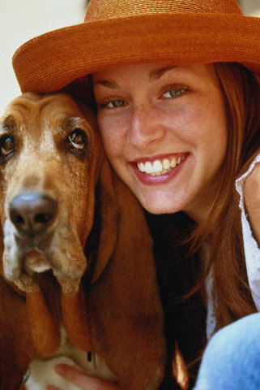
Sarah
(22/ female/ single/ Washington, DC.)
“I like AtomFilms because it’s just about the films”
Personal Background: Liberal arts education at college in the Midwest Just graduated and moved to DC. Has a dog Likes music and art. Went to Lilith Fair. Sends out mass emails about causes she cares about, or jokes.
Profession: Editor for non-profit organization ($35K/yr)
History with Shockwave and/or AtomFilms: First came to AtomFilms because she did a search on Sundance content. She’s heard about the merger with AtomFilms, and is very worried about AtomFilms losing its edge, or begin buried in the Shockwave.com site. She thinks some controversial material might be hidden if AtomFilm gets merged with Shockwave.
Shockwave’s opportunity: If Shockwave can prove they are trustworthy enough to coax her into signing up, she will become a loyal visitor and shortlist subscriber. If she feels clicking through ads will help Shockwave support independent film, she will.

Slide 30
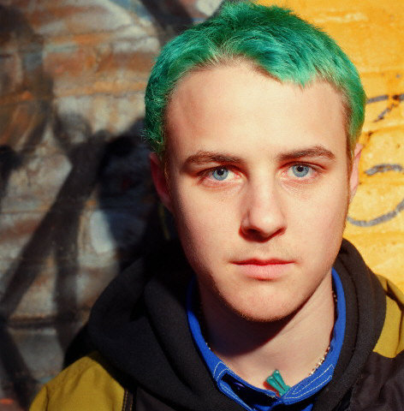
Scott
(17/ male/ single/ Shaumburg, IL.)
“I want something cool and really on the edge. Something you can’t get on TV”
#2 most common user
Profession: Full time student (studies exercise and sport science)
Personal Background: Youngest kid in family of five. Likes to be seen as a little rebellious. Excited to be in college, but not really brave enough yet to actually do anything rebellious, so uses Internet to express his self-image.
History with Shockwave and/or AtomFilms: he’s been to Shockwave a few times, and usually clicks games as soon as the navigation bar loads. He likes playing arcade games, and “shoot ‘em up’s.” Spend two hours playing “King of the Hill paintball” recently.
Shockwave’s opportunity: he is already hanging out in the games section regularly. If shockwave can introduce him to it’s sick and twisted material, it can keep him on the website longer, and use his tendency to send out links to spread the word.

Slide 31
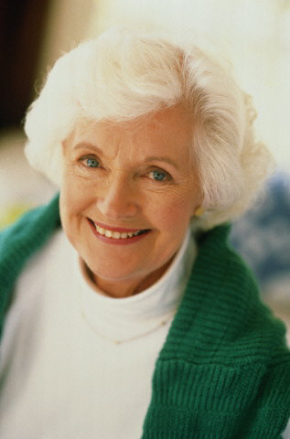
Grace
(62/ female/ widowed/ Little Rock, AR.)
“I like playing my favorite games online, but if I can play with friends, well that’s even better!”
Personal Background: Her husband has passed on. She has two grown kids, both of whom live far away. She misses the kids, but has a fairly large circle of friends that she spends time with.
Technical Proficiency Profile: Limited. Can use her browser and her email. MS Word confuses her, and she doesn’t like using it. Doesn’t know what an OS is. Tends to click yes if the browser prompts her to do anything, and will click wildly until things work.
History with Shockwave and/or AtomFilms: Plays crossword puzzles daily and saves them. Plays card games, PhotoJam, but is offended by South Park cartoons
Shockwave’s opportunity: If Grace can be convinced to participate in community activities, she will become a loyal user of the site. She needs to be sheltered from the sick and twisted content, however.

Slide 32
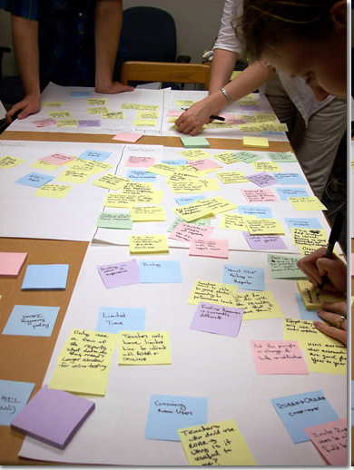
Sort your findings
Specific: Each piece of information should be as precise as possible. Throw out information like, “Users like it to be easy,” and keep information like, “Users need to be able to complete a process in half an hour.”
Relevant: Relevant to your product, not to every site on the Web. Don’t report, “Users like free stuff,” but include, “Many users request free evaluation periods for software to know if paying will be worth it.”
Universal: Find things that are true for the entire site, not for a single item on a single page. Weed out things like, “Users couldn’t find the Submit button on the
checkout page,” but leave in, “We have a type of user who knows what he wants already and needs a way to speed through finding and buying.”
Notes:
Elementary my dear Watson! Specific: Each piece of information should be as precise as possible. Throw out
information like, “Users like it to be easy,” and keep information like, “Users need
to be able to complete a process in half an hour.”
{ Relevant: Relevant to your product, not to every site on the Web. Don’t report,
“Users like free stuff,” but include, “Many users request free evaluation periods for
software to know if paying will be worth it.”
{ Universal: Find things that are true for the entire site, not for a single item on a
single page. Weed out things like, “Users couldn’t fi nd the Submit button on the
checkout page,” but leave in, “We have a type of user who knows what he wants
already and needs a way to speed through fi nding and buying.”
32

Slide 33
5 minutes
Specific: Each piece of information should be as precise as possible. Throw out information like, “Users like it to be easy,” and keep information like, “Users need to be able to complete a process in half an hour.”
Relevant: Relevant to your product, not to every site on the Web. Don’t report, “Users like free stuff,” but include, “Many users request free evaluation periods for software to know if paying will be worth it.”
Universal: Find things that are true for the entire site, not for a single item on a single page. Weed out things like, “Users couldn’t find the Submit button on the
checkout page,” but leave in, “We have a type of user who knows what he wants already and needs a way to speed through finding and buying.”
Write out everything you can think of that you observed on post its

Slide 34
1 minute
Write out age(s), genders, ethnicities and other demographics of people you talked to

Slide 35
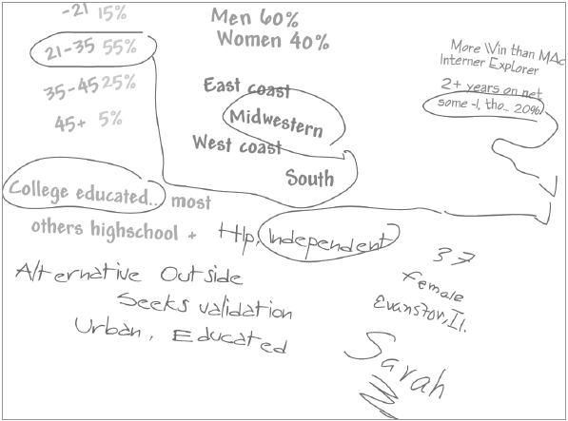
10 minutes group together like
Make pseudo-people
Don’t name them yet
When you see a repeat, place posit on another
Look for a pattern that looks like a person

Slide 36
Share

Slide 37
Enrich
Start adding depth to the personas

Slide 38

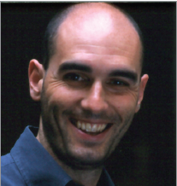

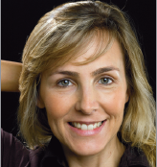
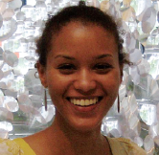

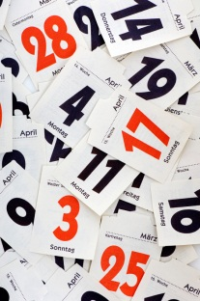
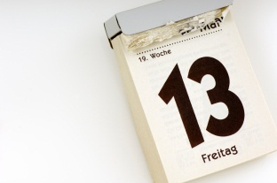
Frequency of Use
Weekly?
Daily
All the time?
Notes:
A group doesn’t just have to be a demographic group. It could be based around similar attitudes, level of engagement, behaviour etc…
ASK students to stop and write these different things on their post its.
38

Slide 39
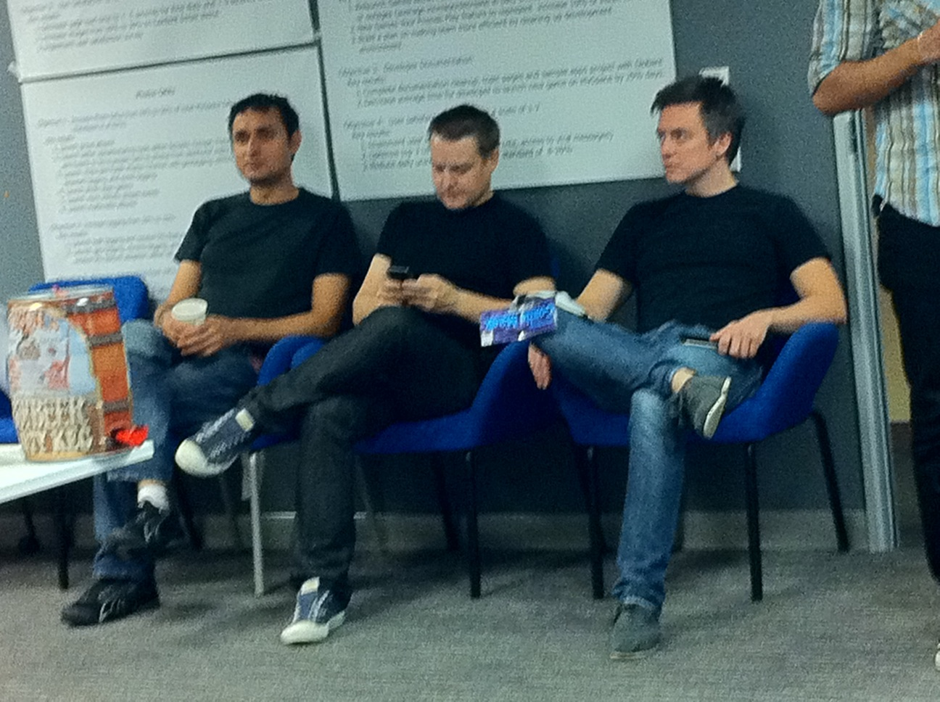
Examples
Eats lunch at desk each day
Eats out with clients
Eats lunch with team

Slide 40
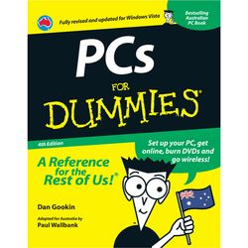
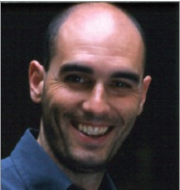
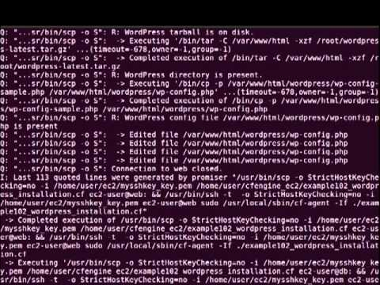
Capability
Computer and IT experience
Novice
Expert
Notes:
A group doesn’t just have to be a demographic group. It could be based around similar attitudes, level of engagement, behaviour etc…
40

Slide 41
Examples
Can find browser if pressed
Excel whiz
Writes own SQL queries

Slide 42
Create details

Slide 43
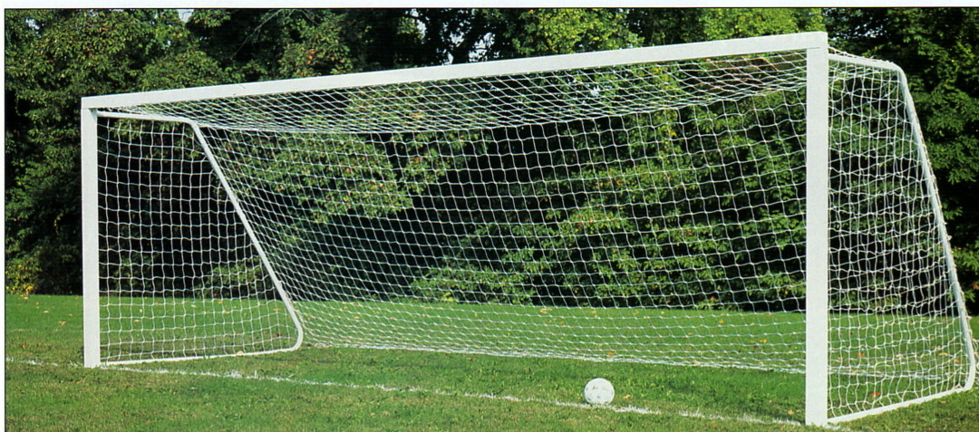
GOAL

Slide 44
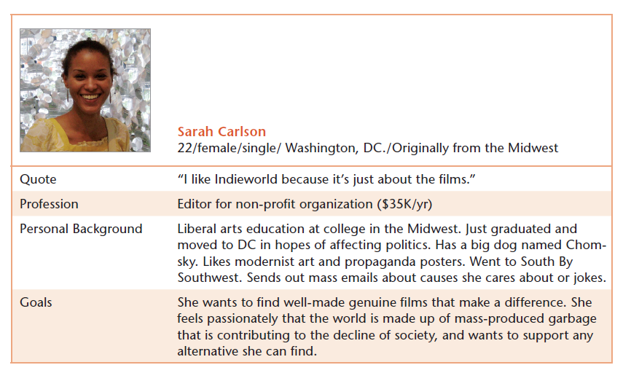
Find well made genuine films that make a difference
Notes:
44

Slide 45
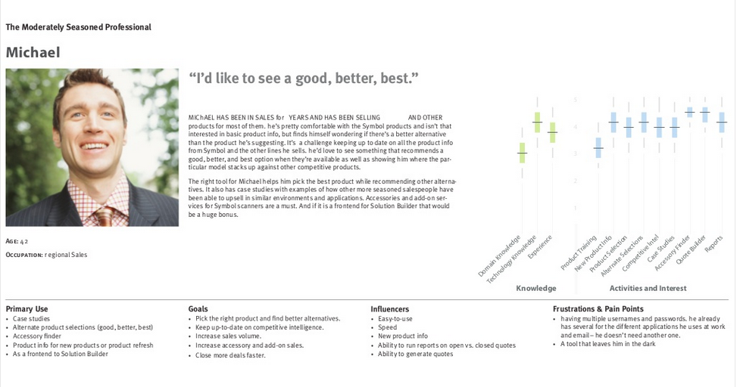
Keep up to date with competitive intelligence
From Todd Warfel’s Persona Talk http://www.slideshare.net/toddwarfel/data-driven-personas

Slide 46
Add Name and goal

Slide 47
Names Matter
Think of your persona as a brand
People are more likely to remember a memorable name e.g.
Phoebe the photographer
Stuart the student
Enrique the engineer
Think memorable, but believable!
Notes:
Comedy names, such as ‘Miguel the Mexican’ are best avoided, as are celebrity names, such as ‘Jo Lo’ or ‘Madonna’

Slide 48

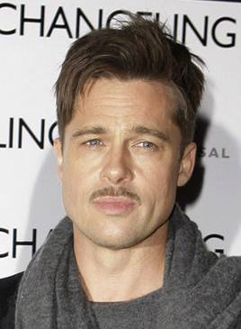
Photos of real people
Toby
The Cambridge new comer
About Toby (28)
Currently lives in Cambridge with his girlfriend
Moved to Cambridge from London 6 months ago
Is an English & drama teacher at a Cambridge high school
Is keen on making some new friends in Cambridge
Uses the Internet most days and will use email and Facebook to keep in touch with friends
“I use the Internet for everything”
Key goals & needs
To know where places are
To find out what is going on locally
To make new fiends
From An introduction to personas for technical authors by Neil Turner http://www.slideshare.net/neiljamesturner/an-introduction-to-personas-for-technical-authors
Notes:
48

Slide 49

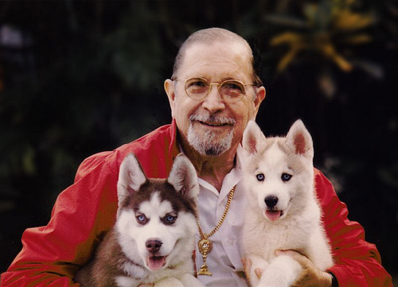
Choose thoughtfully
A person photo should be:
A good size
A head shot
Natural, not too staged
Royalty free
Some good websites for finding photos are:
Flickr
Stock.xchng
Fotolia
Google images
Bad: watermark, staged, and he’s kinda slimey
Good: real person, and easy to like and want to help
Notes:
Comedy names, such as ‘Miguel the Mexican’ are best avoided, as are celebrity names, such as ‘Jo Lo’ or ‘Madonna’
http://www.flickr.com/photos/12433334@N04/2390719990/in/photolist-4Dg4Lb-4Gqfa6-4Mbb3t-4MiAVW-4MkCWW-4NShzN-4Q4hVN-4Rcdv1-4XqeJg-521RhQ-5aFFTB-5f9HRd-5ocznq-5qPRzW-5Tg1Ui-5TkgrC-5Tkgub-5TkkdC-5Tkki1-5UfqRN-5Xgt8t-6gg3ej-6gg5p3-6ghCzf-6hRv2T-6pvxgQ-6su7Zr-6RemDm-6Rk8s2-6RpVSi-7ikFKo-7oGeUc-7rfpZs-bmR5K6-93AGYR-8gyUEC-ahi1ad-7Cf67a-dbbjEu-dq4khD-8r5t8d-8r5Cih-7zwDQf-7Xgegt-9xyerT-8r5Duf-eC1CSZ-avfmYw-eBZEKp-7DCYds-8ndChK
49

Slide 50
Exercise: add detail
Name
Quote
Goal
Frequency
Tech Ability

Slide 51


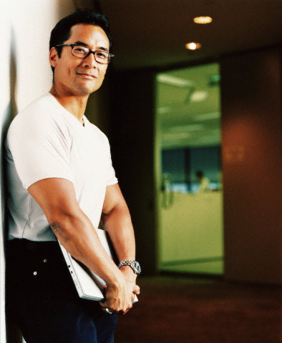


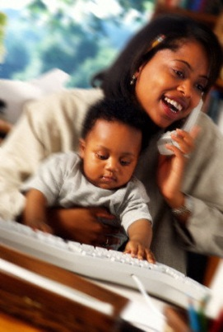

Prioritize personas
Notes:
You can’t have too many personas who are too alike

Slide 52
Prioritization of Personas is essential
To assure that design decisions don't become
generic in the face of too many audiences
To allow for prioritization of research efforts
to Create another filter by which feature level
prioritization can occur

Slide 53




secondary
primary
special
Notes:
Your primary persona needs to be a common user type that is both important to the
business success of the product and is needy from a design point of view. This is usually a
beginning user or a technologically challenged one.
Your secondary users need to be very different from the primary users. Secondary users
may be power users or serious novices who are less valuable from a business standpoint
but cost a lot in customer support. (Business is not just about profi ts; it’s also about
savings.)
There’s a third kind of user, the user who has radically different needs for the system,
who may even need a specialized design of her own. We call these users “complementary,”
because they show us a different side of the product, a side we might not have
seen otherwise.

Slide 54
Tips and tricks

Slide 55
Sanity Check

Slide 56
Are They Real?
Do I know people like this?

Slide 57
Are they Useful?
Is it worth targeting them? Do I have information I can use to make decisions?

Slide 58
Are they Too useful?
Have a made a dream user that isn’t common?

Slide 59
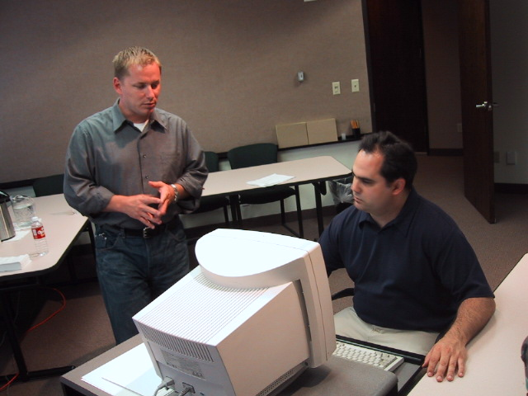
Keep Alive
I’m worried about Sandy. Can she use the profile?
Notes:
If you’re designing a computer system to be used in schools, don’t base your personas on characters from startrick!

Slide 60
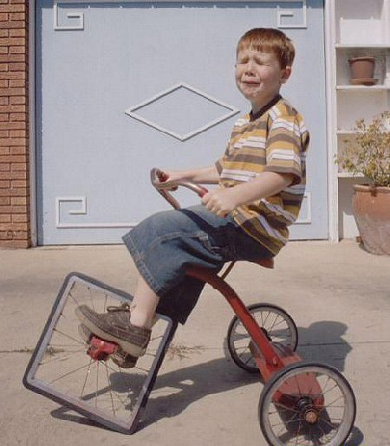
Don’t reinvent for every project
Notes:
60

Slide 61
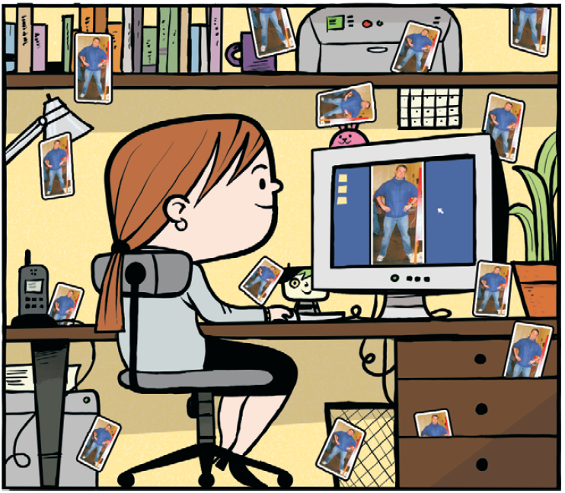
Use personas
Keep them near
Hang them on your wall
Make poster, placemats, puppets
Role-play personas
Evaluate with them
Notes:
Questionnaires are written lists of questions that you distribute to your users, either via an online form, or on paper. They are useful when you wish to survey a larger number or users. They are good for gathering quantitative data, but not qualitative, and can be most useful before performing usability testing to discover areas of potential trouble.
Disadvantages: Users are notoriously poor at self reporting. “Why” is often not answered.

Slide 62
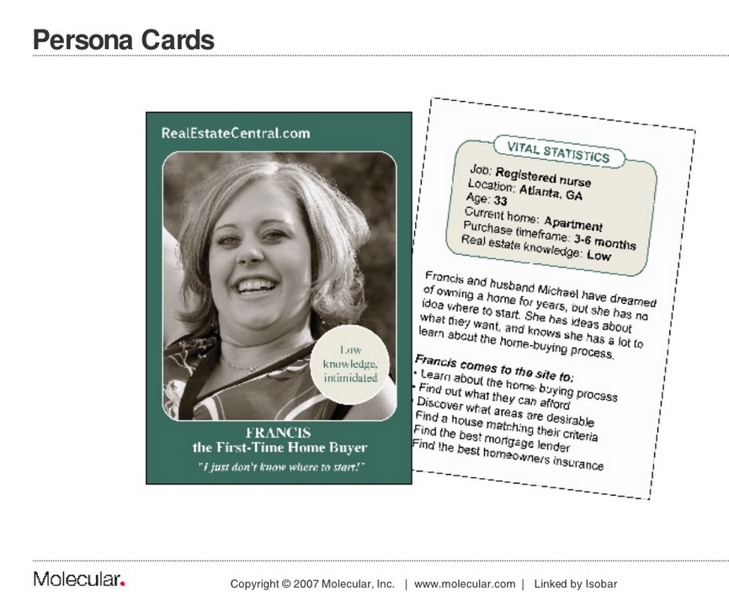
From Steve Mulder’s The User is Always right http://www.slideshare.net/MulderMedia/the-user-is-always-right-making-personas-work-for-your-site
Notes:
These are some persona cards that were created to help everyone get to know the personas. You can see some information about the persona on the back of each card, together with what is important to them and a good quote.

Slide 63
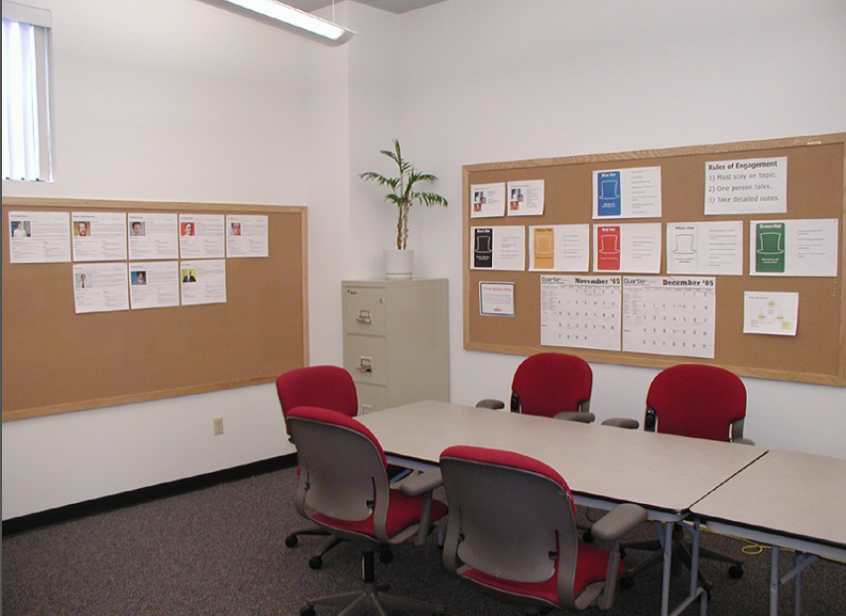

Slide 64
SCENAROS
Notes:
http://www.flickr.com/photos/ul_digital_library/with/8978093756/

Slide 65
User Research
Segments
Personas
Scenarios
Task Analysis
Use Cases
Feature Design

Slide 66
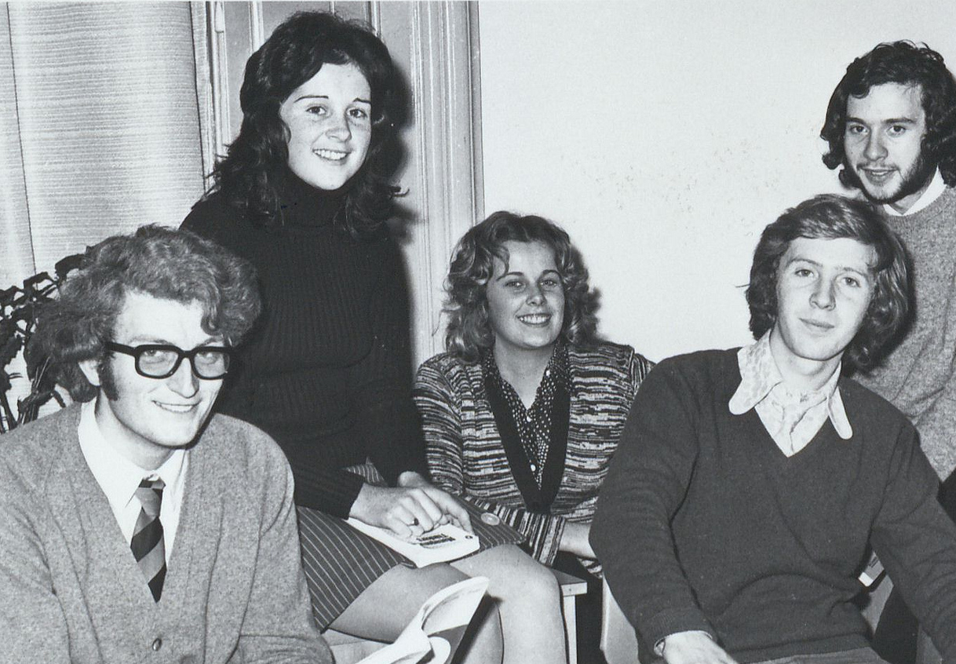
Pick a persona
I want to meet people who face the challenges I do and share advice
What is that’s personas GOAL for using your product?
Tell their story.
The most perfect, magical story of them using your software and everything
is good.
All of life’s hurdles are overcome with your product.
No buttons, no errors. No design yet.
A software that works.
Notes:
Open with an exercise, ~15 minutes for quiet individual scenario writing, then 15 to exchange them. Instructions for exchanging– keep each other honest, point out where you are thinking too much about current constraints like paywalls, or design decisions like buttons and links. Focus on the experience.
Meeting of Drama Society October 1973, Glucksman Library NO COPYRIGHT RESTRICTIONS

Slide 67
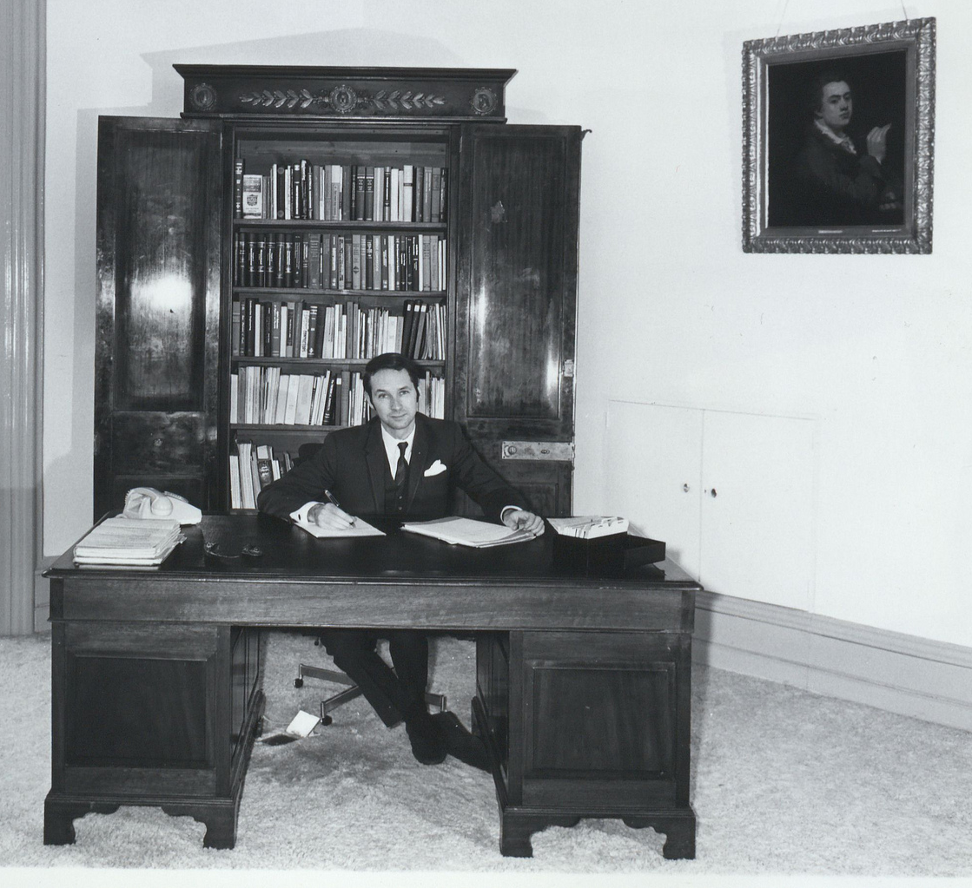
Add business constraints in
Keep the story as positive as possible
Add in log in/registration
Add in check out
Bring business and the user goals together
Resolve tensions
You are going to have to register. And provide a cell number.
Notes:
Now you can add in the business case
Glucksman Library NO COPYRIGHT RESTRICTIONS
ess needs. Discuss what het business wants and the user wants, and if there is a middle ground. Still don’t’ add in design …If you write “he submits the form” you are too detailed.

Slide 68
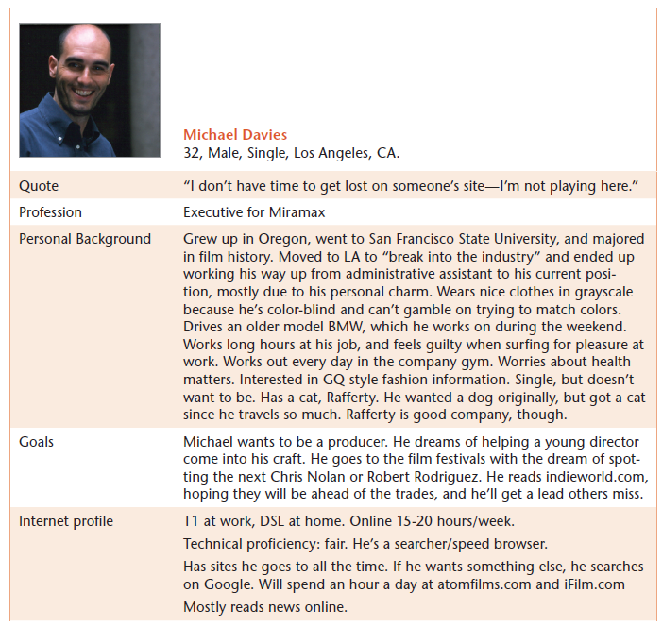
Scenario: Picking films to see
Festival Planner asks Michael if he’s interested in any particular directors or actors. Michael indicates people he thinks have promise. He notices some names he doesn’t know and reads short bios of them. He adds a couple to watch. He notices he can save this information by simply adding his email address and a password. He decides he really ought to because he’s put in a bit of effort at this point. He’s pleased it didn’t ask him for any more personal information; he gets so tired of typing in this and that for registration on every site he comes across. Festival Planner next asks him if he’s interested in any particular genre of film and if he’s traveling for business, pleasure, or both. The Planner asks him if he’s interested only in films that haven’t been signed to a distributor, or if he’s interested in all films. He indicates that he’s interested only in unsigned films. Finally, Festival Planner asks him if he’s willing to see overlapping films, or if he wants the planner to make sure his films dovetail. Michael would rather see complete films, but this is a business trip. He sighs and picks overlap. Festival Planner now gives him a schedule to review, with three films to pick from and an option to “see all for this time slot.” One film for each time slot is indicated as his “best pick.” Each shows how well it meets his taste and needs. Or he can choose to “rest” and not select a film for that time period. Michael goes through the schedule. His wristwatch beeps, and he absent-mindedly shuts it off. He continues to select his films. As he chooses films, he notices an option to get a report on any film when it’s available—he’s very excited by that. If he can’t see them all, at least he can get a sense of what he’s missing!
Persona: Michael
From Information Architecture: Blueprints for the Web by Christina Wodtke
Notes:
Look for verbs, they indicate action.

Slide 69
Adjust for frequency

Slide 70
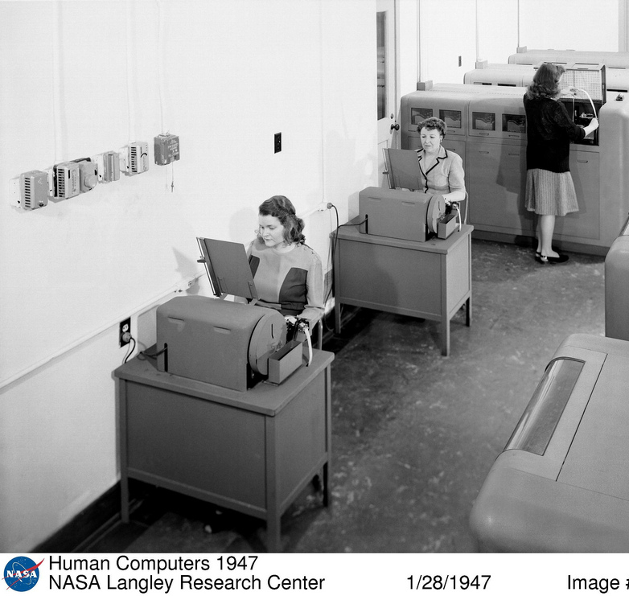
Daily-Use Scenarios
Usually only 2-3 of these
Clear training, quickly removed
Shortcuts & power tools
Customization
Tell the story of the 300th use as well as the 1st
NOT ALL APPS HAVE DAILY USE

Slide 71
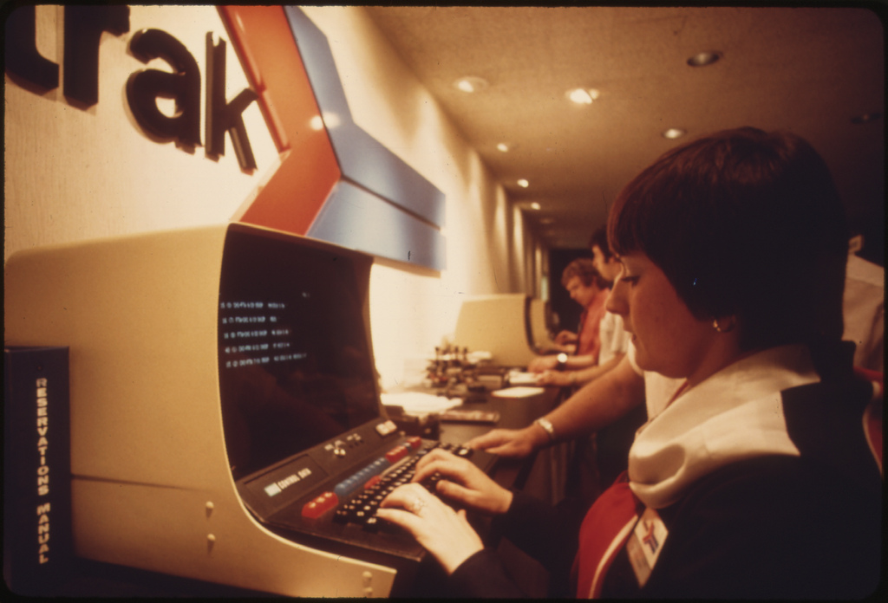
Infrequent, Common Scenarios
Users do it only once in a while
Many users do it – core to business
Expected to “just work”
Users unlikely to pay close attention
Needs excellent unobtrusive help
Will be taught each use
Notes:
Users looking up a train schedule or tickets at amtrak… they don’t expect to have to deal with a tutorial, they just want in and out

Slide 72

Necessary-Use Scenarios
Must be done, but aren’t done often
User needs to get right, be comfortable it works
Changing printer cartridges, clearing memory, fighting a virus, visiting a potentially infected website, deleting a lot of files
Must have good help/pedagogy
Must have excellent error handling
No need for customization or shortcuts

Slide 73

Edge-Case Scenario
Unusual situations
Programmers must handle, or code will not work
Design can largely ignore beyond quick fixes.
Work on last (or not at all)

Slide 74


Slide 75


Exercise: Revise your scenarios
Daily?
Common Infrequent?
Notes:
SDASM ArchivesSan Diego Air & Space

Slide 76
Communicating Scenarios

Slide 77
When Stan is out of the office and working at a client’s location, the last thing he feels like doing at the end of a long day is entering his hours into his company’s time tracking tool. So he usually puts this off until Friday and then grimaces to himself at 6:00 as he launches the VPN tool, logs in, and then points his Web browser to the intranet home page. Fortunately, there’s a link to the time tracking tool right on the home page, along with other commonly used tools.
Once in the time tracking tool, he’s happy to see that it remembers his activities from the previous week, so all he has to do is enter new hours for this week for the same activities. He started a new project this week, so he clicks New Project and selects his client from the list that appears, then easily enters his hours. Soon he’s finished, and what used to take a half hour now takes ten minutes. He glances at the total to make sure all the hours are there, then clicks Submit.
After the confirmation message appears, the Web browser redirects Stan to the intranet home page, where he immediately notices that yesterday’s company presentation is now available. He missed the meeting, so he quickly downloads the presentation to look at while he’s on the flight home tomorrow. While it’s downloading, he sees from a dashboard on the home page that the company message board has come to life with a discussion about what Web 2.0 means to the business. He can’t resist clicking to see what Riccardo has to say on this topic, and before he knows it spends 15 minutes reading various posts. He even posts a quick URL of a Google Maps mashup he just found.
Notes:
People may not read your scenarios

Slide 78



Storyboards
Kim Goodwin, Designing for the digital age
Notes:
Simpel wireframe+ text

Slide 79


Comics
Kevin Change, See What I Mean
Notes:
Comics for emotion
http://kevnull.com/2011/09/see-what-i-mean-short-talk-at-wordcamp-sf.html
http://boxesandarrows.com/comics-not-just-for-laughs/

Slide 80



Can’t draw?
Stick figures!
Photos!
Clipart!
Philgreg.tv
Boxesandarrows.com
t Kevin Change, See What I Mean
Notes:
http://boxesandarrows.com/comics-not-just-for-laughs/
http://www.almostexact.com/2011/08/how-to-test-a-new-website-or-concept/
http://philgreg.tv/courses/comiclife/

Slide 81
Regardless of how you present them, what you want to leave with is a clear idea of what requirements and features you have.
Notes:
Regardless of how you present them, what you want to leave with is a clear idea of what requirements and features you have.
User Stories – are just another way to phrase requirements – talk about them a little bit.

Slide 82
Share

Slide 83
Task Analysis & Use Cases
Break it on down
Notes:
Notes: you need to have the scenarios out.
Images in this presentation: http://www.flickr.com/photos/ul_digital_library/with/8978093756/

Slide 84
User Research
Segments
Personas
Scenarios
Task Analysis
Use Cases
Feature Design

Slide 85

Task analysis
Can be used to
Understand current behavior
Optimize current behavior
Design for new behavior
In Designing you
Break down a story into discrete tasks
Identify branching decision points
Notes:
Wallace "Whitey" Wolf, a Mechanic for the City Sweeps Out the Repair Garage ..., 10/1974
US National Archive

Slide 86

Task Analysis during Research
Why the user is performing the task (that is, the underlying goal)
Frequency and importance of the task
Cues — what initiates or prompts the execution of the task
Dependencies — what must be in place to perform the task, as well as what is
dependent on the completion of the task
People who are involved and their roles and responsibilities
Specific actions that are performed
Decisions that are made
Information that is used to support decisions
What goes wrong — errors and exception cases
How errors and exceptions are corrected
Notes:
The U.S. National Archives Member since 2009
Taken on August 12, 1942

Slide 87


From a McDonald’s patent application on sandwich making
Notes:
Mcdonalds uses task analysis to optimize for speed and accurate reproduction.

Slide 88


Slide 89
Task Analysis
How to Design
Notes:
Get out a scenarios

Slide 90
Highlight youR verbs

Slide 91
Scenario: Picking films to see
Festival Planner asks Michael if he’s interested in any particular directors or actors. Michael indicates people he thinks have promise. He notices some names he doesn’t know and reads short bios of them. He adds a couple to watch. He notices he can save this information by simply adding his email address and a password. He decides he really ought to because he’s put in a bit of effort at this point. He’s pleased it didn’t ask him for any more personal information; he gets so tired of typing in this and that for registration on every site he comes across. Festival Planner next asks him if he’s interested in any particular genre of film and if he’s traveling for business, pleasure, or both. The Planner asks him if he’s interested only in films that haven’t been signed to a distributor, or if he’s interested in all films. He indicates that he’s interested only in unsigned films. Finally, Festival Planner asks him if he’s willing to see overlapping films, or if he wants the planner to make sure his films dovetail. Michael would rather see complete films, but this is a business trip. He sighs and picks overlap. Festival Planner now gives him a schedule to review, with three films to pick from and an option to “see all for this time slot.” One film for each time slot is indicated as his “best pick.” Each shows how well it meets his taste and needs.
Persona: Michael
From Information Architecture: Blueprints for the Web by Christina Wodtke
Notes:
Look for verbs, they indicate action.

Slide 92
Pull out the steps

Slide 93
Goal: Michael wants to quickly set up a schedule for Sundance.
1. Understand how it works.
2. Choose films of interest.
3. Select film state of availability (signed, unsigned).
4. Select film scheduling (dovetail or overlap).
5. View recommendation.
6. Select films of choice.
7. Sign up for reports.
8. Save work (available in previous steps).
9. Email schedule.
From Information Architecture: Blueprints for the Web by Christina Wodtke
Notes:
Pull the tasks out of the scenarios
“Here we try to get the basic unique tasks. This sequence isn’t necessarily written in
stone. For example, in our design, we hope to make “Save work” available at any stage.
However, we know that “Save work” is really, really important later in the process. So, for
now, we’ll leave it in the sequence of the scenario.”

Slide 94
Goal: Michael wants to quickly set up a schedule for Sundance.
Next: Break down into subtasks
2. Choose films of interest.
a. Select directors of interest.
b. Select actors of interest.
c. Select genres of interest.
From Information Architecture: Blueprints for the Web by Christina Wodtke
Notes:
Pull the tasks out of the scenarios
“Here we try to get the basic unique tasks. This sequence isn’t necessarily written in
stone. For example, in our design, we hope to make “Save work” available at any stage.
However, we know that “Save work” is really, really important later in the process. So, for
now, we’ll leave it in the sequence of the scenario.”

Slide 95
Find subtasks

Slide 96

Goal: Michael wants to quickly set up a schedule for Sundance.
From Information Architecture: Blueprints for the Web by Christina Wodtke
Notes:
Diagram, rather than text. Same end result.

Slide 97
Try flowchart instead of words

Slide 98




Visual Vocabulary
A simple, useful set of shapes to communicate interaction and hierarchy, used for both flows and sitemaps.

Slide 99

From Jesse James Garrett’s Reverse engineered Yahoo Mail

Slide 100
Reverse Engineer a Competitor
Advice

Slide 101
User Research
Segments
Personas
Scenarios
Task Analysis
Use Cases
Feature Design

Slide 102

Use cases
A use case from our task analysis
This is just more formal and careful documented task analysis, useful to programmers.
It covers both the dream scenario, but also any issues inherent in the actual system.
Both user AND system behavior is outlined.
Used in specifications documents. Often written by product managers… but is that a good idea?
From Information Architecture: Blueprints for the Web by Christina Wodtke
Notes:
Discuss: is design happening here? Who knows the users best? Who should write this?

Slide 103
HEADER
Q&A

